Slide 1
Hashing Algorithms

Slide 2
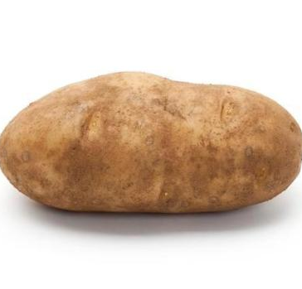
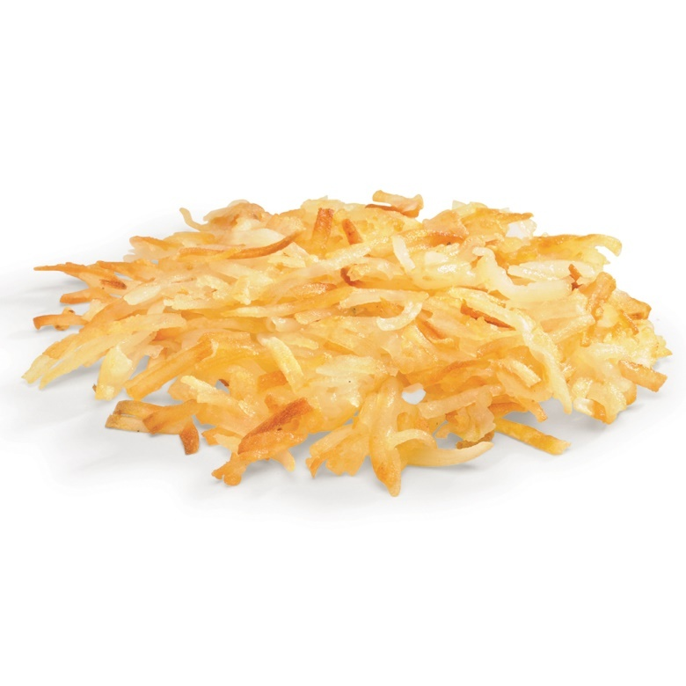
What is a hash anyway?
Algorithm that converts any input into a unique output value
One-way
You cannot extract the original input from a hash
That would be encryption and not hashing
Like making hash browns from a potato
You cannot get back to the potato once it’s been made into hash browns!

Slide 3
Purpose
Used for verifying data integrity or password equality
Ensure the data has not changed en route
User enters password, hash value computed, hash is stored
User comes back, enters password, hash value computed and compared
User’s password is never stored plaintext
Compare hash sent along with document (or posted online) with hash computed on recipient’s end

Slide 4

File integrity
MD5 Hash-o-matic
Here’s the file you requested. The MD5 hash is a26ae0c181268bcb91d5e5ead574c79a

Slide 5
File integrity
Thanks, I’ll check the hash value now.
MD5 Hash-o-matic
Here’s the file you requested. The MD5 hash is a26ae0c181268bcb91d5e5ead574c79a

Slide 6
File integrity
Here’s the file you requested. The MD5 hash is a26ae0c181268bcb91d5e5ead574c79a
Thanks, I’ll check the hash value now.
Great. That looks like the hash you gave me. Now I know nobody has tampered with the file!
MD5 Hash-o-matic
a26ae0c181268bcb91d5e5ead574c79a

Slide 7
If someone has tampered with the file…
OR

Slide 8
File integrity
Here’s the file you requested. The MD5 hash is a26ae0c181268bcb91d5e5ead574c79a
Thanks, I’ll check the hash value now.
Great. That looks like the hash you gave me. Now I know nobody has tampered with the file!
Uh-oh! That is not the same MD5 hash value. This file has been changed somehow. Please resend it.
MD5 Hash-o-matic
80b83e2dd0de3fd22caba009748de93f

Slide 9
MD5 – Message Digest Algorithm
Designed by Ronald Rivest
First released in 1992
Replaced MD4
128-bit hash value
Vulnerabilities found in 1996
Not collision resistant
December 2008: Researchers created CA certificate that appeared legitimate when MD5 is checked
Built other certificates that appeared to be legit and issued by the company RapidSSL

Slide 10

MD5 collision
Following two large values generate the same MD5 hash
Collisions are bad for secure, trust-worthy encryption!
Solution is often to make resulting hash values larger
d131dd02c5e6eec4693d9a0698aff95c 2fcab58712467eab4004583eb8fb7f89 55ad340609f4b30283e488832571415a 085125e8f7cdc99fd91dbdf280373c5b d8823e3156348f5bae6dacd436c919c6 dd53e2b487da03fd02396306d248cda0 e99f33420f577ee8ce54b67080a80d1e c69821bcb6a8839396f9652b6ff72a70 | d131dd02c5e6eec4693d9a0698aff95c 2fcab50712467eab4004583eb8fb7f89 55ad340609f4b30283e4888325f1415a 085125e8f7cdc99fd91dbd7280373c5b d8823e3156348f5bae6dacd436c919c6 dd53e23487da03fd02396306d248cda0 e99f33420f577ee8ce54b67080280d1e c69821bcb6a8839396f965ab6ff72a70
MD5 Hash: 79054025255fb1a26e4bc422aef54eb4 | MD5 Hash: 79054025255fb1a26e4bc422aef54eb4

Slide 11
Secure Hashing Algorithm (SHA)
Developed by National Security Agency (NSA)
US Federal Information Processing Standard (FIPS)
FIPS 180-4
SHA-1
In wide use
160-bit digest (hash value)
Collision possibilities discovered 2005
SHA-2
Preferred SHA type
Up to 512-bit digest
SHA-1 no longer used by US Government

Slide 12
HMAC
Hash-based Message Authentication Code
Combines hash with secret key (like a salt)
Name implies which hash method was used: HMAC-MD5, HMAC-SHA256
Verifies both data integrity and authenticity
Used in network encryption protocols
IPSec, TLS

Slide 13
RIPEMD
RACE Integrity Primitives Evaluation Message Digest
RACE
Research and Development in Advanced Communication Technologies in EU
Created to help with EU Broadband Communications
Centralized cryptographic standards and control
Original RIPEMD was found to have collision issues in 2004
Replaced by RIPEMD-160 (no known collisions)
Similar to MD4 in design but performs more like SHA-1
Like SHA, other types/modes: RIPEMD-128, RIPEMD-256, RIPEMD-320

